Slide 1

Software Design (swD392)
Ch15 - Designing Client Server Software Architectures

Slide 2
Main Contents
Overview
Multiple Client/Single Service Architectural Pattern
Multiple Client/Multiple Service Architectural Pattern
Architectural Communication Patterns for Client/Server Architectures
Middleware in Client/Server Systems
Design of Service Subsystems
Design of Wrapper Classes
From Static Models to Relational Database Design

Slide 3

Overview
In client/server systems
a client is a requester of services
a server is a provider
of services
Typical servers are
file servers,
database servers,
line printer servers

Slide 4
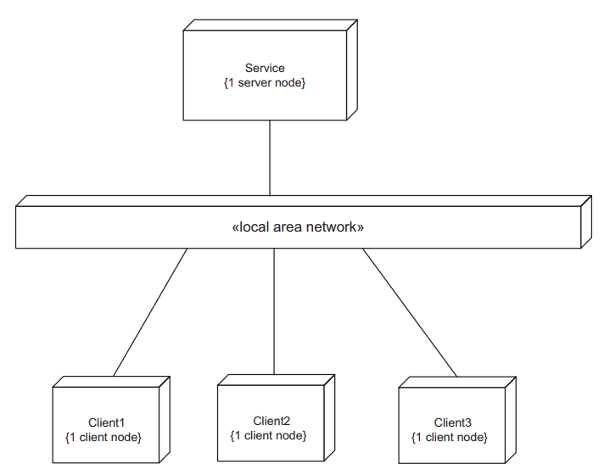
Multiple Client/Single Service Architectural Pattern 1/3
Multiple Client/Single Service architectural pattern

Slide 5
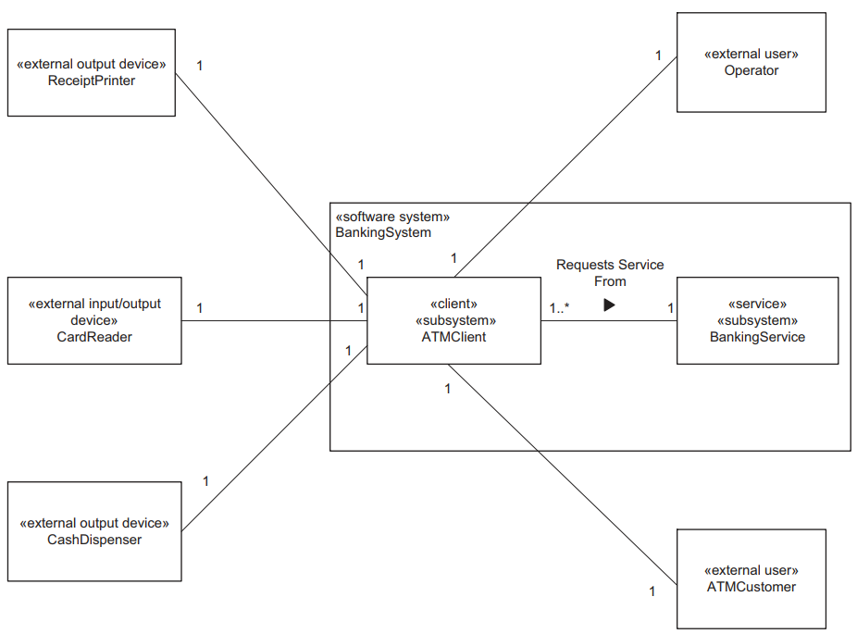
Multiple Client/Single Service Architectural Pattern 2/3
Example of Multiple Client/Single Service architectural pattern: Banking System

Slide 6
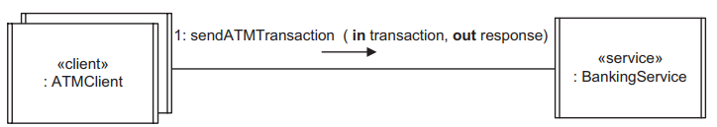
Multiple Client/Single Service Architectural Pattern 3/3
Consists of several clients that request a service & a service that fulfills client requests
The simplest and most common client/server architecture has one service and many clients.
Multiple Client/Single Service architectural pattern is also known as the Client/Server or Client/Service pattern

Slide 7
Multiple Client/Multiple Service Architectural Pattern 1/3
More complex client/server systems might support multiple services
In addition to clients requesting a service, a client might communicate with several services, and services might communicate with each other.
A client could communicate with each service sequentially or could communicate with multiple services concurrently.

Slide 8
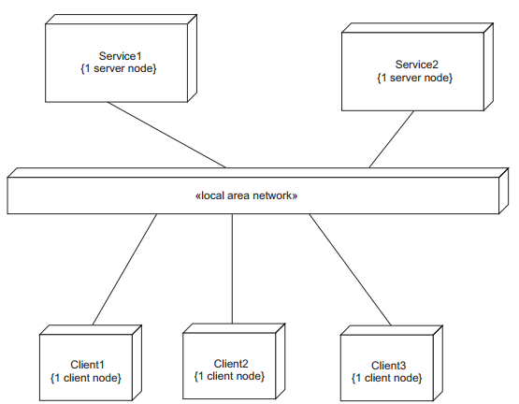
Multiple Client/Multiple Service Architectural Pattern 2/3
Multiple Client/Multiple Service architectural pattern

Slide 9
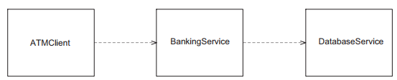
Multi-tier Client/Service Architectural Pattern
The Multi-tier Client/Service pattern has an intermediate tier (i.e., layer) that provides both a client and a service role.
An intermediate tier is a client of its service tier and also provides a service for its clients.
It is possible to have more than one intermediate tier. When viewed as a layered architecture, the client is considered to be at a higher layer than the service because the client depends on and uses the service.

Slide 10
Architectural Communication Patterns for Client/Server Architectures 1/3
In client/server communication, there is usually a request from a client to a service, and a response from the service.
In some cases, there might not be a service response, for example, when data are being updated instead of requested.
The nature of the communication between the client and service affects the communication patterns used.

Slide 11
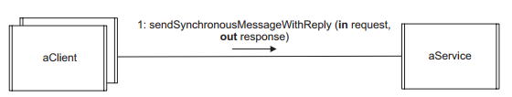
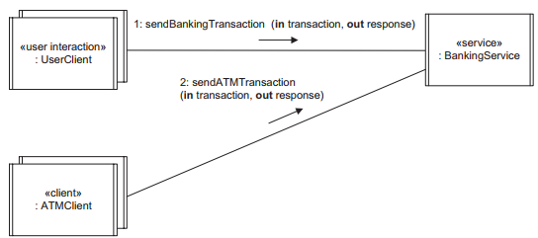
Architectural Communication Patterns for Client/Server Architectures 2/3
Synchronous Message Communication with Reply Pattern
Examples of the Synchronous Message Communication with Reply pattern: Banking application
Notes:
Synchronous Message Communication with Reply (Figure 15.7) can involve a single client sending a message to a service and then waiting for a reply, in which case no message queue develops between the client and the service.
However, it is more likely to involve multiple clients interacting with a single service, as described next. In the typical client/server situation, each client sends a request message to a service and waits for a response from it. In this pattern, because there are several clients sending service requests, a message queue can build up at the service. The client uses synchronous message communication and waits for a response from the service.

Slide 12
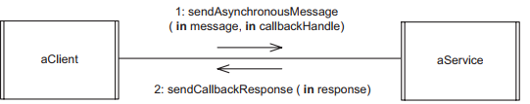
Architectural Communication Patterns for Client/Server Architectures 3/3
Asynchronous Message Communication with Callback Pattern
Used between a client and a service when the client sends a request to the service and can continue executing without needing to wait for the service response; however, it does need the service response later.
The callback is an asynchronous response to a client request message sent previously. This pattern allows the client to execute asynchronously but still follows the client/service paradigm in which a client sends only one message at a time to the service and receives a response from the service.
With the callback pattern, the client sends a remote reference or handle, which is then used by the service to respond to the client.
A variation on the callback pattern is for the service to delegate the response to another component by forwarding to it the callback handle.

Slide 13
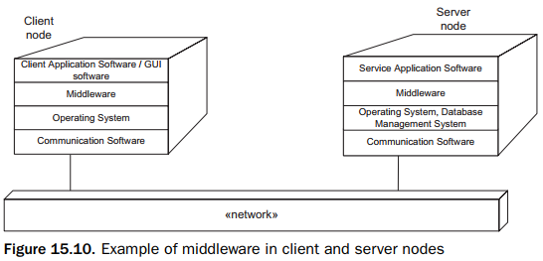
Middleware in Client/Server Systems
Middleware is a layer of software that sits above the heterogeneous operating system to provide a uniform platform above which distributed applications, such as client/server systems, can run
Notes:
Heterogeneous: ko đồng nhất
An example of middleware in a client/server configuration is shown in Figure 15.10. On the client node is the client application, which uses a graphical user interface (GUI). There is a standard operating system, such as Windows, and network communication software, such as TCP/IP (Transmission Control Protocol/Internet Protocol), which is the most widely used protocol on the Internet. A middleware layer sits above the operating system and the network communication software. On the server node is the service application software, which makes use of the middleware services that reside on top of the operating system (e.g., UNIX, Linux, or Windows), and the network communication software. A file or database management system, usually relational, is used for long-term information storage.

Slide 14
Design of Service Subsystems
A service subsystem provides a service for multiple clients
It is very common for services to need access to a database in which persistent data are stored
A simple service does not initiate any requests for services but responds to requests from clients.
There are two kinds of service components: sequential and concurrent.

Slide 15
Design of Service Subsystems Sequential Service Design 1/2
A sequential service is designed as one concurrent object (thread of control) that processes client requests sequentially; that is, it completes one request before it starts servicing the next.
The service typically has a message queue of incoming service requests.
There is one message type for each operation provided by the service.
The service coordinator unpacks the client’s message and, depending on the message type, invokes the appropriate operation provided by a service object.
The parameters of the message are used as the parameters of the operation.
The service object processes the client’s request and returns the appropriate response to the service coordinator, which then prepares a service response message and sends it to the client.
Notes:
For example, a simple sequential service responds to requests from clients to update or read data from a passive data abstraction object. When the service receives a message from a client, it invokes the appropriate operation provided by the passive data abstraction object – for example, to credit or debit an account object in a banking application.

Slide 16
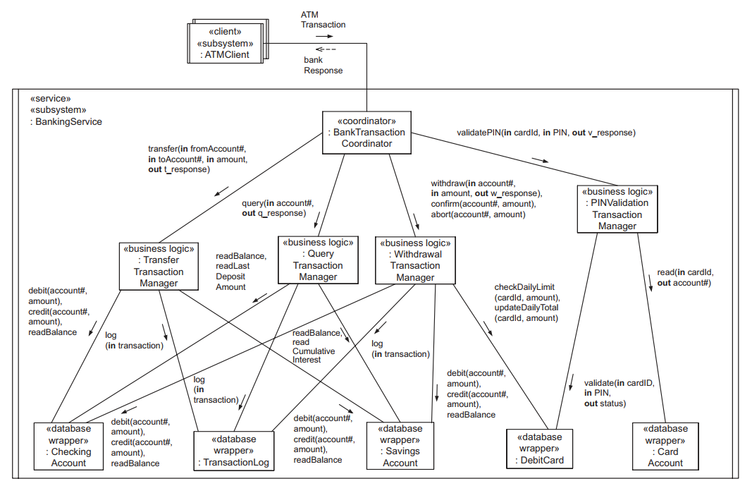
Design of Service Subsystems Sequential Service Design 2/2
Banking Service services the transaction, invokes the service operation, returns a bankResponse message to the client, and then services the next transaction
Notes:
The Banking Service sequentially services ATM transactions from clients requesting PIN validation, withdrawals from accounts, transfers between accounts, and account queries. Banking Service services the transaction, invokes the service operation, returns a bankResponse message to the client, and then services the next transaction. Each transaction is executed to completion before the next transaction is started. The sequential service design should only be used if the server node can adequately handle the transaction rate.
The service is designed using the layers of abstraction pattern. Because the service data are stored in a relational database, at the lowest level of the architecture are database wrapper objects (see Section 15.6), which encapsulate how the data are accessed from the database. At the next layer are the business logic objects, which encapsulate the business rules for processing client requests. At the highest layer is the coordinator object, which uses the facade pattern to provide a uniform interface for clients. The fac¸ade is provided by a coordinator object that presents a common interface to clients. During execution, the coordinator (the object providing the fac¸ade) delegates each incoming client request to the appropriate business logic object, which in turn interacts with the database wrapper objects that access the database, where the account and debit card data are stored.
Thus, when an ATM Client sends a PIN validation request to the Banking Service, the request is received by the Bank Transaction Coordinator, which delegates it to the PIN Validation Transaction Manager. This business logic object will then access both the Debit Card and Card Account database wrapper objects to carry out the validation and return the validation response to the coordinator, which in turn sends a synchronous response to the client request.

Slide 17
Design of Service Subsystems Concurrent Service Design 1/2
The service functionality is shared among several concurrent objects. If the client demand for services is high enough that the sequential service could potentially become a bottleneck in the system, an alternative approach is for the services to be provided by a concurrent service consisting of several concurrent objects.
This approach assumes that improved throughput can be obtained by objects providing concurrent access to the data – for example, if the data are stored on secondary storage

Slide 18
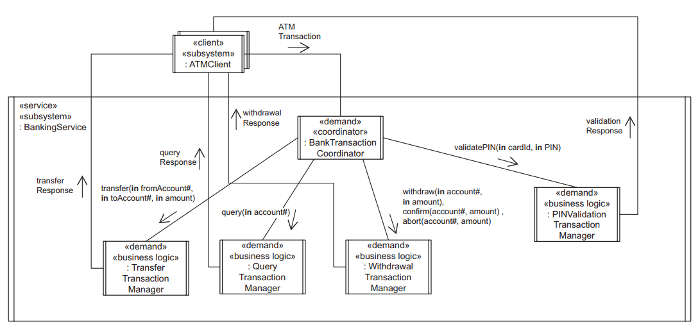
Design of Service Subsystems Concurrent Service Design 2/2
The Bank Transaction Coordinator and each transaction manager is designed as a separate concurrent object
The clients communicate with the service by using the Asynchronous Message Communication with Callback pattern
Notes:
The Bank Transaction Coordinator and each transaction manager is designed as a separate concurrent object. The Bank Transaction Coordinator delegates individual transactions to the individual transaction managers to allow concurrent processing of transactions. More than one instance of each transaction manager could also be executed. Access to the database wrapper objects (not shown) also needs to be synchronized.
In this example, the clients communicate with the service by using the Asynchronous Message Communication with Callback pattern. This means that the clients do not wait and can do other things before receiving the service response. In this case, the service response is handled as a callback. With the callback approach, the client sends an operation handle with the original request. The service uses the handle to remotely call the client operation (the callback) when it finishes servicing the client request.
Bank Transaction Coordinator passes the ATM Client’s callback handle to the appropriate transaction manager. On completion, the transaction manager concurrent object remotely invokes the callback, which is depicted as the appropriate service response message sent to the ATM client.

Slide 19
Design of Wrapper Classes
In the analysis model, an entity class is designed that encapsulates data.
During design, a decision has to be made whether the encapsulated data are to be managed directly by the entity class or whether the data are actually to be stored in a database.
The former case is handled by data abstraction classes, which encapsulate data structures
The latter case is handled by database wrapper classes, which hide how the data are accessed if stored in a database

Slide 20
Design of Wrapper Classes Database Wrapper Classes 1/2
Data abstraction classes are more likely to be designed on the client side, but they might also be needed on the server side.
Database wrapper classes are much more likely to be designed on the server side, because that is where the database support is provided
Most databases in use today are relational databases, so the database wrapper class provides an object-oriented interface to the database
The attributes of the analysis model entity class are mapped to a database relational table
The operations to access the attributes are mapped to a database wrapper class.
The database wrapper class hides the details of how to access the data maintained in the relational table, so it hides all the SQL statements.

Slide 21
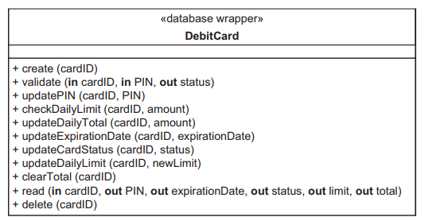
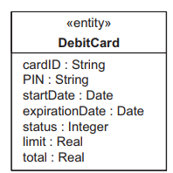
Design of Wrapper Classes Database Wrapper Classes 2/2
In the Banking System example, all persistent data are stored in a relational database. Hence, each entity class maintained at the bank server is mapped to both a database relational table and a database wrapper class

Slide 22
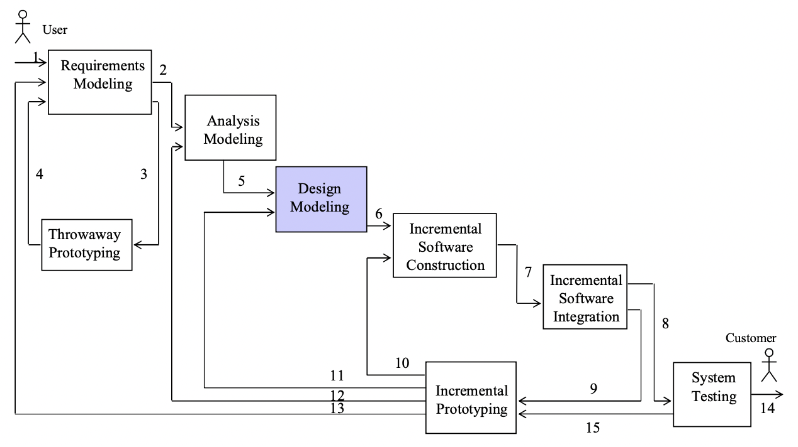
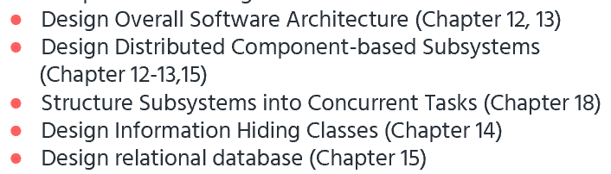
From Static Models to Relational Database Design
Relational database design (RDD) models information and data into a set of tables with rows and columns. Each row of a relation/table represents a record, and each column represents an attribute of data. The Structured Query Language (SQL) is used to manipulate relational databases
Steps in Using COMET/UML
Develop Software Requirements Model
Develop Software Analysis Mode
Develop Software Design Model
Design Overall Software Architecture (Chapter 12, 13)
Design Distributed Component-based Subsystems (Chapter 12-13,15)
Structure Subsystems into Concurrent Tasks (Chapter 18)
Design Information Hiding Classes (Chapter 14)
Design relational database (Chapter 15)

Slide 23
From Static Models to Relational Database Design
Relational Database Design
1. Objective: Map static model to relational database
2. Each entity class from static model that needs to be stored in relational database:
Entity class maps to one (or more) relation(s) (table)
Attributes mapped to columns of table
Each object instance maps to a row of table
3. Relational Database Design:
Primary keys
Foreign keys for associations
Association classes
Aggregation/Composition Hierarchy
Generalization/Specialization hierarchy

Slide 24
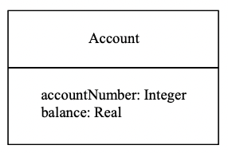

From Static Models to Relational Database Design
Entity Classes and Relational Tables
Account entity class
Account relational table

Slide 25
From Static Models to Relational Database Design
Primary Keys
1. Each relation must have a primary key
2. Primary Key:
Combination of one or more attributes
Uniquely locates a row in relation
E.g., Account Number is primary key of Account relation
Account (Account number, Balance) – (underline = primary key)

Slide 26
From Static Models to Relational Database Design
Relational Database Design Foreign Keys
1. Associations in relational databases:
Many-to-many association in static model
Maps to a relation
One-to-one and one-to-many associations
Use Foreign keys
2. Foreign key:
Primary key of one table that is embedded in another table
Represents mapping of association between relations into a table
Allows navigation between tables

Slide 27
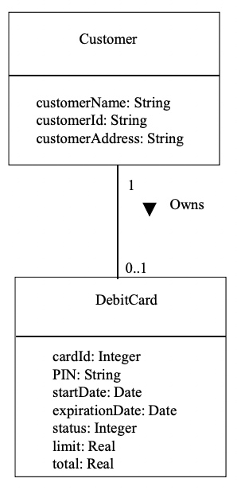
From Static Models to Relational Database Design
One-to-one or Zero-or-one Association 1/2
One-to-one association maps to:
Foreign key in one of relations
Zero-or-one association maps to:
Foreign key in optional relation
E.g., Customer Owns Debit Card
Static model:
Customer (Customer Name, Customer Id, Customer Address)
Debit Card (Card Id, PIN, Expiration date, Status, Limit, Total)

Slide 28
From Static Models to Relational Database Design
One-to-one or Zero-or-one Association 2/2
1. Relational Database Design:
Customer Id chosen as primary key of Customer
Customer (Customer Name, Customer Id, Customer Address)
Card id chosen as primary key of Debit Card relation
2. Customer Id chosen as foreign key in Debit Card
3. Represents association between Customer and Debit Card relations
4. Debit Card (Card Id, PIN, Expiration date, Status, Customer Id)
(underline = primary key, italic = foreign key)

Slide 29
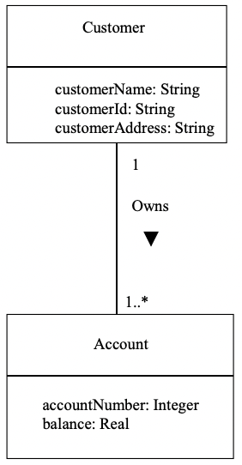
From Static Models to Relational Database Design
One-to-Many Association 1/2
One-to-many association maps to:
Foreign key in “many” relations
E.g., Customer Owns Account
Static model:
Customer (Customer Name, Customer Id, Customer Address)
Account (Account number, Balance)
Relational Database Design:
Primary key of “one” relation (Customer) is chosen as foreign key in “many” relation (Account)

Slide 30
From Static Models to Relational Database Design
One-to-Many Association 2/2
Relational Database Design:
Customer Id chosen as primary key of Customer relation
Customer (Customer Name, Customer Id, Customer Address)
Account Number is chosen as primary key of Account relation
Customer Id is foreign key in Account relation
Account (Account Number, Balance, Customer Id)

Slide 31
From Static Models to Relational Database Design
Static Model Association Class 1/2
An association class models association between two or more classes and is typically used to represent a many-to-many association
Association class is mapped to associative relation
Associative relation
Relation to represent association between two or more relations
Primary key of associative relation
Concatenated key
Formed from primary key of each relation that participates in association

Slide 32
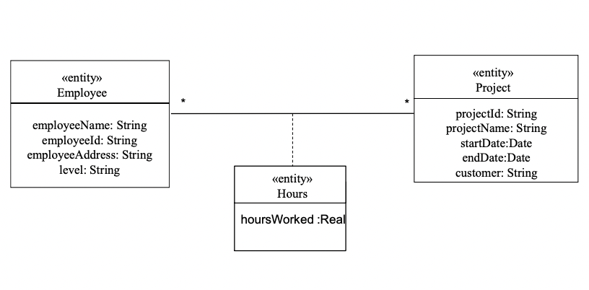
From Static Models to Relational Database Design
Static Model Association Class 2/2
E.g., Hours association class:
Represents association between Project and Employee classes
Mapped to Associative relation Hours
Static model:
Project (Project id, Project name)
Employee (Employee id, Employee name, Employee address)
Hours (Hours Worked)
Hours Worked is attribute of association

Slide 33
From Static Models to Relational Database Design
Relational Database Design Associative Relation
Relational Database Design
Project (Project id, Project name)
Employee (Employee id, Employee name, Employee address)
Project id and Employee id
Form concatenated primary key of Hours relation
Also foreign keys
Hours (Project id, Employee id, Hours worked)

Slide 34
From Static Models to Relational Database Design
Static Model Aggregation/Composition Hierarchy
Whole/part relationship
Aggregate/Composite (whole) class is mapped to relation
Each part class is mapped to relation
Primary key of aggregate/composite relation
All of primary key of component relation
1-1 aggregation
Part of primary key of component relation
1-n aggregation
Foreign key
If not needed to uniquely identify component relation

Slide 35
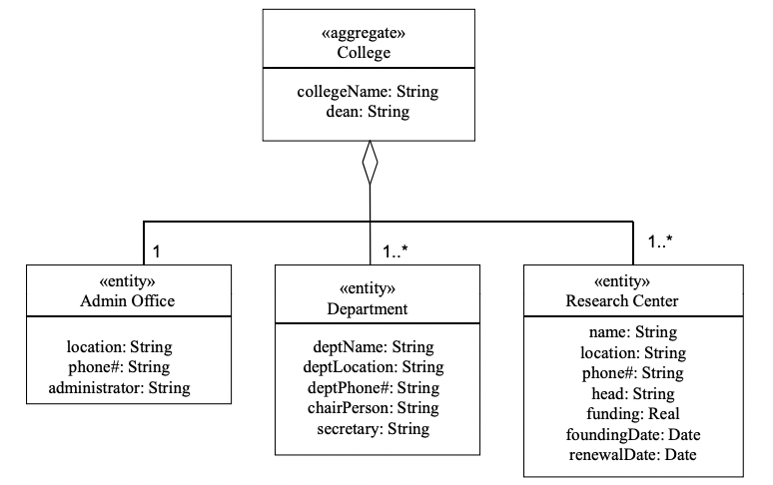
From Static Models to Relational Database Design
Relational Database Design Aggregation / Composition Hierarchy
E.g., Static Model:
Department IS PART OF College
Admin Office IS PART OF College
College (College name)
Admin Office (Location)
Department (Department name,
Location)
Relational Database Design:
Primary key of aggregate relation = College name
College (College name)
Admin Office (College name, Location)
Department (Department name, College name, Location)

Slide 36
From Static Models to Relational Database Design
Static Model Generalization / Specialization Hierarchy
Three alternative mappings from Generalization / Specialization Hierarchy to relational database
Superclass & subclasses mapped to relations
Subclasses only mapped to relations
Superclass only mapped to relation

Slide 37
From Static Models to Relational Database Design
Relational Database Design Generalization / Specialization Hierarchy 1/4
Superclass & subclasses mapped to relations
Superclass mapped to table
Discriminator is attribute of superclass table
Each subclass mapped to table
Shared id for primary key
Same primary key in superclass and subclass tables
Clean and extensible
However, superclass / subclass navigation may be slow

Slide 38
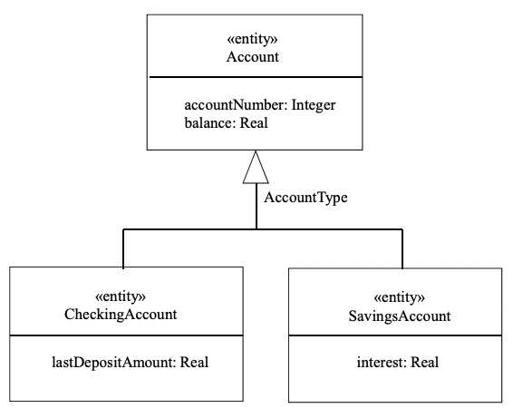
From Static Models to Relational Database Design
Relational Database Design Generalization / Specialization Hierarchy 2/4
Superclass & subclasses mapped to relations
E.g.: Account Generalization / Specialization Hierarchy
Static Model
Superclass: Account (Account number, Balance)
Subclass: Checking Account (Last Deposit Amount)
Subclass: Savings Account (Interest)
Relational Database Design
Account (Account number, Account Type, Balance)
Checking Account (Account Number, Last Deposit Amount)
Savings Account (Account Number, Interest)

Slide 39
From Static Models to Relational Database Design
Relational Database Design Generalization / Specialization Hierarchy 3/4
1. Superclass only mapped to relations
Map each subclass to relation
No superclass relation
Superclass attributes replicated for each subclass table
2. Can use if
Subclass has many attributes
Superclass has few attributes
Application knows what subclass to search

Slide 40
From Static Models to Relational Database Design
Relational Database Design Generalization / Specialization Hierarchy 4/4
1. Superclass only mapped to relations
2. All subclass attributes brought up to superclass table
Discriminator is attribute of superclass table
Each record in superclass table uses attributes relevant to one subclass
Other attribute values are null
3. Can use if
Superclass has many attributes
Subclass has few attributes
Only two or three subclasses

Slide 41
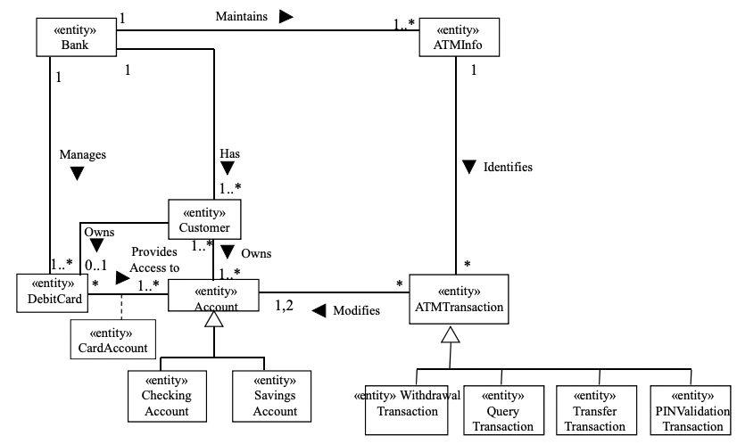
From Static Models to Relational Database Design
Example of Relational Database Design 1/2

Slide 42
From Static Models to Relational Database Design
Example of Relational Database Design 2/2
Banking System static mode
Bank Information (underline = primary key, italic = foreign key):
Bank (bankName, Bank Address, bankId)
ATM Info (bankId, ATMId, ATM Location, ATM Address)
Customer (customerName, customerId, customerAddress)
Debit Card (cardId, PIN, startDate, expirationDate, status, limit, total, customerId)
Checking Account (accountNumber, accountType, balance, lastDepositAmount)
Savings Account (accountNumber, accountType, balance, interest) Card Account (cardId, accountNumber)
Customer Account (customerId, accountNumber)
Assumption: Account type is determined from account number

Slide 43


